Slide 1

AUTOMATION TESTING OF WEBSITE
Under Guidance of Mrs. Vaishali Sonanis Ma’am.
PRESENTATION BY: NINAD PRAMOD NASIKKAR

Slide 2
Introduction
nopCommerce is an open-source e-commerce platform used by businesses and individuals.
It is a comprehensive solution offering powerful features such as product management, multi-store support, secure payments, and advanced marketing tools.
It is highly customizable, scalable, and suitable for businesses of all sizes.
nopCommerce enables a seamless shopping experience with its responsive UI and support for multiple currencies.
nopCommerce is a comprehensive platform offering a wide range of products, including electronics, apparel, books, jewellery and more.

Slide 3
Overview
The main objective is:
To test the functionalities of nopCommerce website using manual and automation testing.
To create project requirements.
To prepare module wise test plan.
To execute module wise test cases.
To identify defects and prepare defect report.
To use tools like Cucumber and Selenium for automation testing.

Slide 4
Modules
Module 1 : Registration
Checked all the functionalities on the registration page which included personal info. like name, email address, password, company.
Module 2 : Login
Checked all the functionalities on Login page which included email address, password.
Module 3 : Search
Checked all the functionalities to search for a product using the search box.
Notes:
Module 1: Signn in page
Checked all the functionalities on Sign in page which included personal info as email
address, password
Module 2: Women page
Checked all the functionalities on Women page which included item details, Quantity, Filters,compare button,Add to cart button,product info,grid,list button
Module 3: Tshirt page
Checked all the functionalities on T-Shirt page which included item details, Quantity, Filters,compare button,Add to cart button,product info,grid,list button
Module 4: All Buttons and Drop Down Arrow :
team checked if all the buttons and drop down arrows of different fields are functioning properly or not

Slide 5
Modules
Module 4 : Add to cart
Checked all the functionalities to add a product to cart using the ADD TO CART button.
Module 5: Delete from cart
Checked whether a product added to the cart can be removed or not.
Module 6 : Currency Selection
Checked whether the currency selection feature works correctly by switching between US DOLLARS and EURO.
Notes:
Module 1: Signn in page
Checked all the functionalities on Sign in page which included personal info as email
address, password
Module 2: Women page
Checked all the functionalities on Women page which included item details, Quantity, Filters,compare button,Add to cart button,product info,grid,list button
Module 3: Tshirt page
Checked all the functionalities on T-Shirt page which included item details, Quantity, Filters,compare button,Add to cart button,product info,grid,list button
Module 4: All Buttons and Drop Down Arrow :
team checked if all the buttons and drop down arrows of different fields are functioning properly or not

Slide 6
Modules
Module 7: Add to wishlist
Checked the functionality of ADD TO WISHLIST icon.
Module 8: Social Media
. Verified whether all the social media handles(Instagram, Facebook, Youtube, X) of nopCommerce are opening correctly or not.
Module 9 : Address
Checked the functionality of adding a new address.
Module 10: Change password and Logout
Checked whether user is able to change the current password. Also, verified the logout functionality.
Notes:
Module 1: Signn in page
Checked all the functionalities on Sign in page which included personal info as email
address, password
Module 2: Women page
Checked all the functionalities on Women page which included item details, Quantity, Filters,compare button,Add to cart button,product info,grid,list button
Module 3: Tshirt page
Checked all the functionalities on T-Shirt page which included item details, Quantity, Filters,compare button,Add to cart button,product info,grid,list button
Module 4: All Buttons and Drop Down Arrow :
team checked if all the buttons and drop down arrows of different fields are functioning properly or not

Slide 7
Defects
While running a testcase at certain point some fields are not working as it is expected which is nothing but a defect.
So, I have created a Defect report on those defects.

Slide 8
Defect Identifier : def_home_page_banner_001
Defect summary : Expected result= After clicking on 'learn more' button on the Samsung galaxy S24 banner on the home page, it should navigate to detailed product info. Page Actual result=After clicking on 'learn more' button on the Samsung galaxy S24 banner on the home page, the same page reloads and no detailed product information is displayed
Test id : tc_008
Test case name : learn_more_button_clickable
Module name : Search Module
reproducible(steps) : 1. Open the website url. 2. Login. 3. Click on 'learn more' button on home page banner.
Severity : Medium
Priority : Medium
raised by : Ninad (tester)
assigned to : Reeva shah(Test lead name)
Date of assignment : 04/09/2025
Status : open
fixed by : Shiva Upadhyay(developer name)
Approvals : Murali Pradhan(manager)

Slide 9
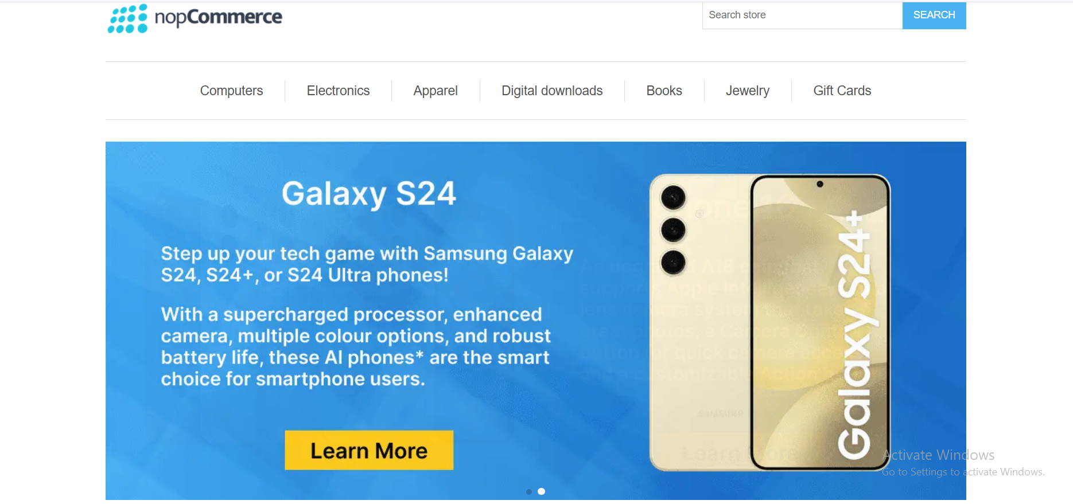

Slide 10
Defect Identifier : def_about_us_002
Defect summary : Expected result= After clicking on 'About Us' hyperlink in the footer section, it should display the information about nopCommerce website . Actual result= After clicking on 'About Us' hyperlink in the footer section,"Put your "About Us" information here. You can edit this in the admin site." message is displayed
Test id : tc_011
Test case name : about_Us_clickable
Module name : Social Media Module
reproducible(steps) : 1. Open the website url. 2. Scroll down to the footer section. 3. Click on the 'About Us' hyperlink
Severity : Low
Priority : Low
raised by : Ninad (tester)
assigned to : Reeva shah(Test lead name)
Date of assignment : 04/09/2025
Status : open
fixed by : Shiva Upadhyay(developer name)
Approvals : Murali Pradhan(manager)

Slide 11
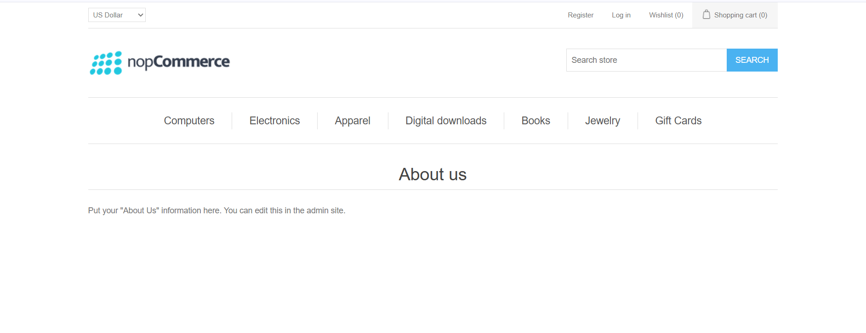

Slide 12
Challenges
While testing big website like nopCommerce which contains huge data I faced some challenges about:
Registration details not retained, causing repeated re-registration.
Test cases passed in unit testing but failed during integration testing.
Difference arises between expected results in written test cases and actual outcomes during execution.

Slide 13
Experience
Gained practical experience in identifying and reporting bugs through both manual and automation testing.
Learned the importance of strong observation skills while performing manual testing.
Experienced real-time challenges such as integration failures.
Learned to validate key ecommerce functionalities like add-to-cart, change password, and currency selection.
Enhanced skills in using automation tools like Selenium and Cucumber for testing.

Slide 14
Thank You!!!
Vaishali ma’am for guiding us throughout the project.

